Slide 1

MTech Seminar High Performance OTA Design Bhawana Srivastava 203079017 Supervisor : Prof Rajesh Zele Department of Electrical Engineering Indian Institute of Technology, Bombay

Slide 2
Content
Motivation
Design challenges
Drawback of other schemes
Two Stage Feedforward Compensation OTA
No Capacitor Feedforward Compensation (NCFF)
Circuit Realization
Three stage split-path Feedforward Compensation
Features
Implicit FFC scheme
gm/ID methodology-based data-driven search algorithm
Algorithm
Fourth-Order Amplifier
Summary
References

Slide 3
Motivation
Designing a High performance OTA for circuit which requires fast settling
Increasing demand of OTA with high gain and high bandwidth
Ex: Delta Sigma ADC, Analog to Digital Converters, Switch Capacitor filters

Slide 4
Design challenges
High gain and High BW amplifier have contradicting design need:
High gain => Multistage amplifier with long channel length transistor
High BW => Single stage amplifier and short channel length transistor
N Cascade stage => N x gain but N low frequency poles
Low phase margin

Slide 5
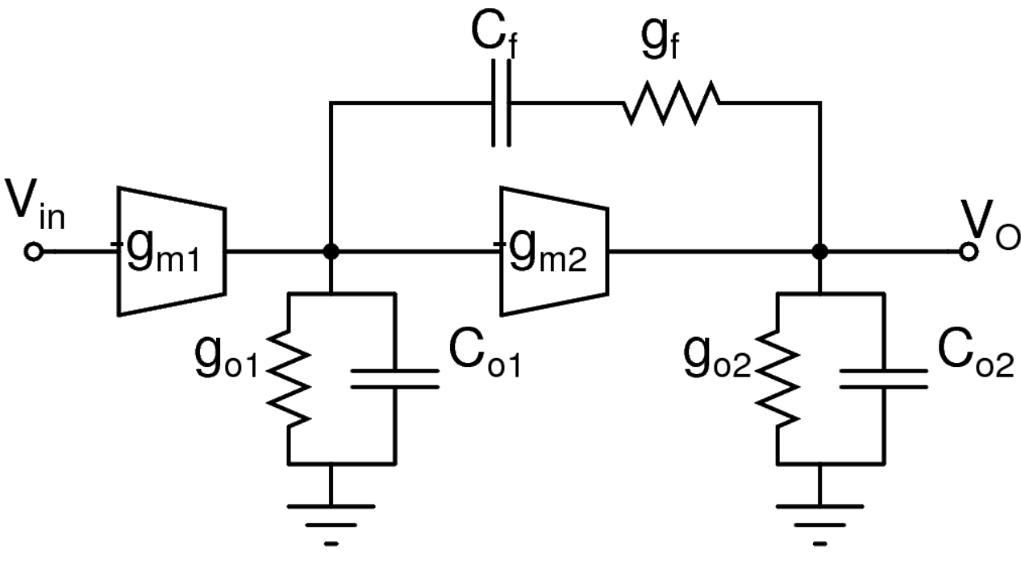
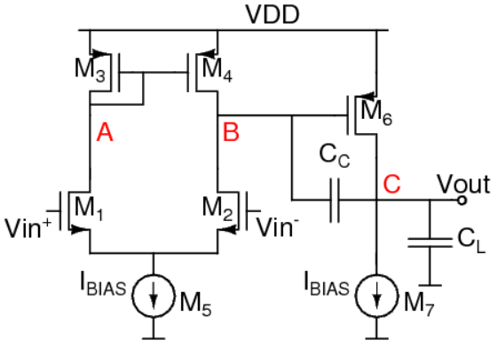
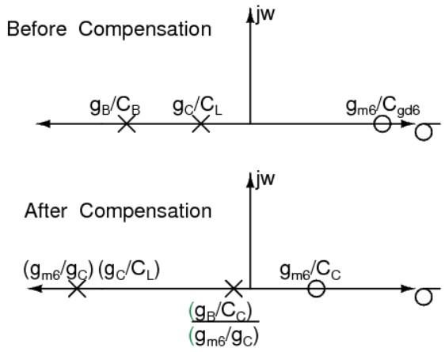
Drawback of other schemes
Design with Miller Capacitors:
Dominant pole is pushed at lower frequency => Reduced bandwidth
Introduces RHP zero => Decreased phase margin
Nulling resister used => Cancel the effect of RHP zero
Fig. Miller frequency compensation block dia.
Fig. Pole-zero location of Miller compensation
Fig. Miller compensation Circuit

Slide 6
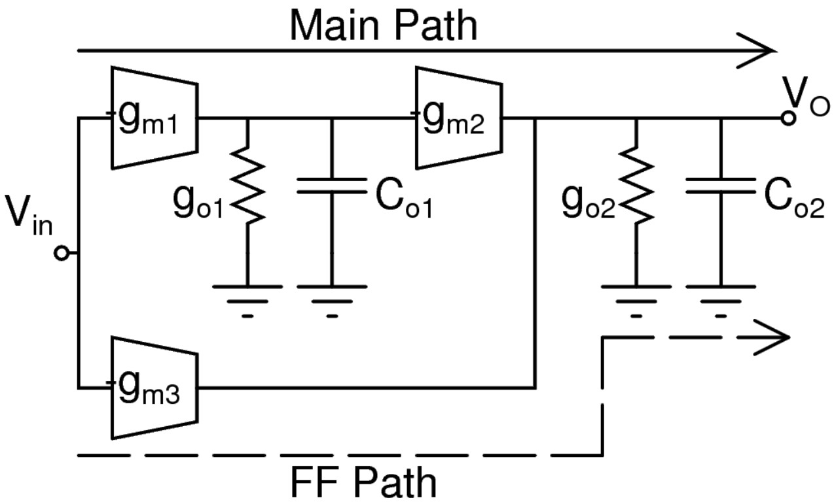
No Capacitor Feedforward Compensation (NCFF) [1]
No use of Miller Capacitor for compensation
No pole splitting and no RHP zero
High bandwidth
Circuit become faster
Feedforward compensation is used
Creates LHP zero
Phase margin increases
Compensate the negative phase shift due to poles
Two stage OTA
Gain increases at low frequency
Less Error
Fig. Block diagram of basic Two stage FF compensation

Slide 7

Two Stage Feedforward Compensation OTA [1]
DC gain of 1st stage, Av₁ = g_{m1}/g_{o1}
1st stage has dominant pole, w_{p1} = g_{o1}/C_{o1}
DC gain of 2nd stage, Av₂ = g_{m2}/g_{o2}
DC gain of feedforward stage, Av₃ = g_{m3}/g_{o2}
2nd stage and feedforward path have common pole, w_{p2} = g_{o2}/C_{o2}
Unity gain bandwidth, w_{GBW} = A_{V1} A_{V2} w_{p1} =
$$A_{V2}\frac{g_{m1}}{C_{o1}}$$
Fig. Block diagram of basic Two stage FF compensation

Slide 8
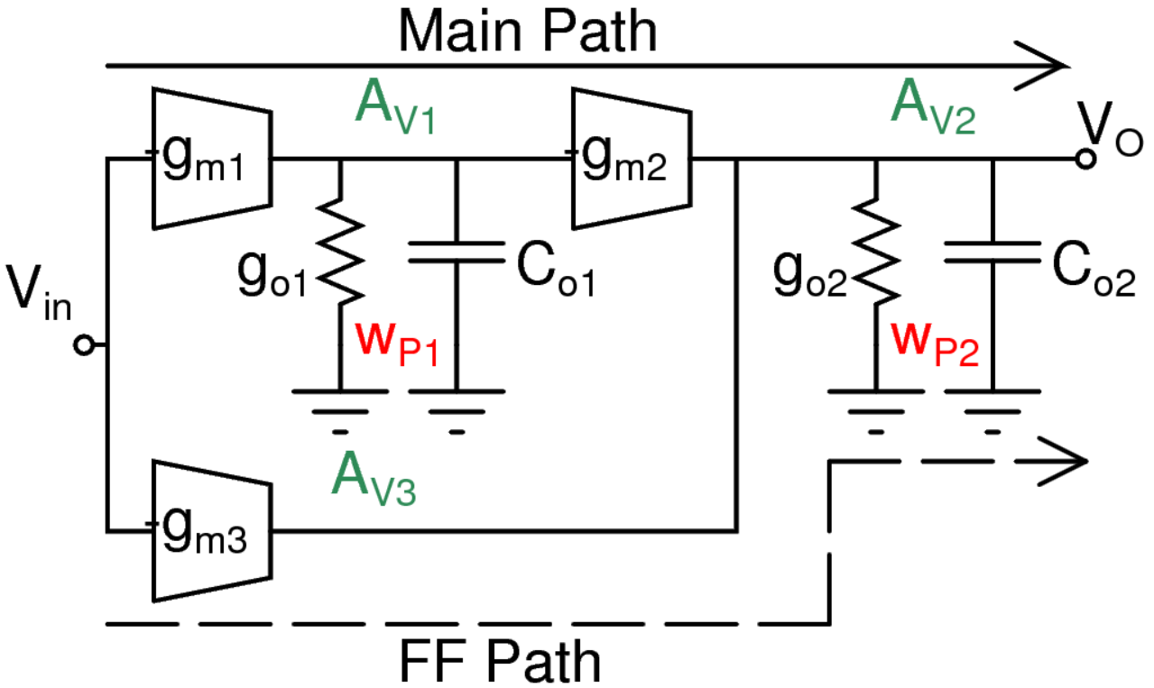


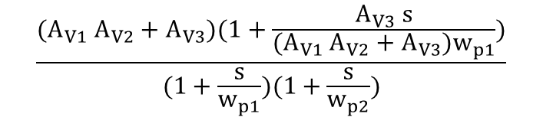

The overall Amplifier Gain:
H(s) ≈
One LHP Zero and Two LHP poles
Overall DC gain is $A_{V1} A_{V2}+A_{V3}$
LHP zero:
w_{z} =
≈
Location of LHP zero => 1st stage gain bandwidth product X Constant
$$\frac{{(A}_{V1} A_{V2}+A_{V3})(1+\frac{A_{V3} s}{{{(A}_{V1} A_{V2}+A_{V3})w}_{p1}})}{(1+\frac{s}{w_{p1}})(1+\frac{s}{w_{p2}})}$$
$$\frac{A_{V1}A_{V2}{+ A}_{V3}}{A_{V3}} w_{p1}$$
$$\frac{g_{m1}}{C_{o1}}\frac{g_{m2}}{g_{m3}}$$
Fig. Block diagram of basic Two stage FF compensation

Slide 9



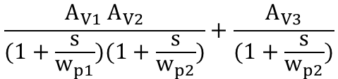


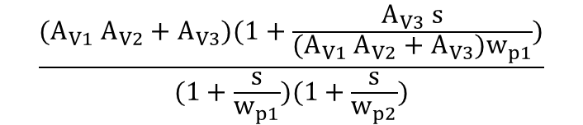
The overall Amplifier Gain: [1]
H(s) ≈
=
=
LHP Zero and Two poles
LHP zero: [1]
w_{z} = -
= -
= -
= -
≈ 1st stage gain bandwidth product * Constant
$$\frac{A_{V1} A_{V2}}{(1+\frac{s}{w_{p1}})(1+\frac{s}{w_{p2}})}+\frac{A_{V3}}{(1+\frac{s}{w_{p2}})}$$
$$\frac{A_{V1}A_{V2}{+ A}_{V3}}{A_{V3}} w_{p1}$$
$$\frac{A_{V1} A_{V2}+A_{V3}(1+\frac{s}{w_{p1}})}{(1+\frac{s}{w_{p1}})(1+\frac{s}{w_{p2}})}$$
$$(1+\frac{A_{V1}A_{V2}}{A_{V3}}) w_{p1}$$
$$(1+\frac{\frac{g_{m1}}{g_{o1}}\frac{{ g}_{m2}}{g_{o2}}}{\frac{g_{m3}}{g_{o2}}})\frac{g_{o1}}{C_{o1}}$$
$$\frac{{(A}_{V1} A_{V2}+A_{V3})(1+\frac{A_{V3} s}{{{(A}_{V1} A_{V2}+A_{V3})w}_{p1}})}{(1+\frac{s}{w_{p1}})(1+\frac{s}{w_{p2}})}$$
$$\frac{g_{m1}}{C_{o1}}\frac{g_{m2}}{g_{m3}}$$
[1] B. K. Thandri and J. Silva-Martinez, "A robust feedforward compensation scheme for multistage operational transconductance amplifiers with no Miller capacitors".
9

Slide 10
Features [1]
Pole of 2nd stage/feedforward path and zero of feedforward path compensate
Overall phase margin will be 90° due to the only pole present
Reduced area and power from those multistage amplifiers which uses capacitor for compensation
Considering Non dominant pole of 1st stage will give total of 3 poles and 2 LHP zeros
Number of LHP zero = Order of 1st stage
Placing w_{p2} after w_{UGB} => Increased Phase Margin
Pole-zero cancellation at high frequency => Best settling time
Fig. Block diagram of basic Two stage FF compensation

Slide 11
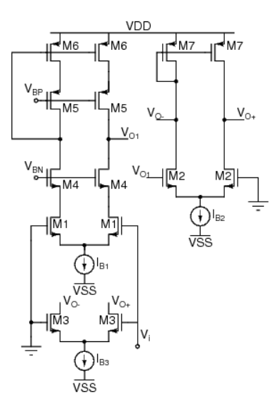
Circuit Realization [1]
Telescopic amplifier: M₁, M₄, M₅, M₆ : High DC gain
DC gain of 1st stage: Av₁ = g_{m1} {(g_{m4} r_{ds4} r_{ds1} ) || (g_{m5} r_{ds5} r_{ds6} )}
2nd stage: M₂, M₇ : Single ended differential amp
DC gain of 2nd stage: Av₂ = g_{m2} (r_{ds2} || r_{ds3} || r_{ds7} )
Feedforward path: M₃, M₇ : Single ended diff amp
DC gain of feedforward stage: Av₃ = g_{m3} (r_{ds2} || r_{ds3} || r_{ds7} )
Fig. Single ended amplifier with NCFF compensation

Slide 12
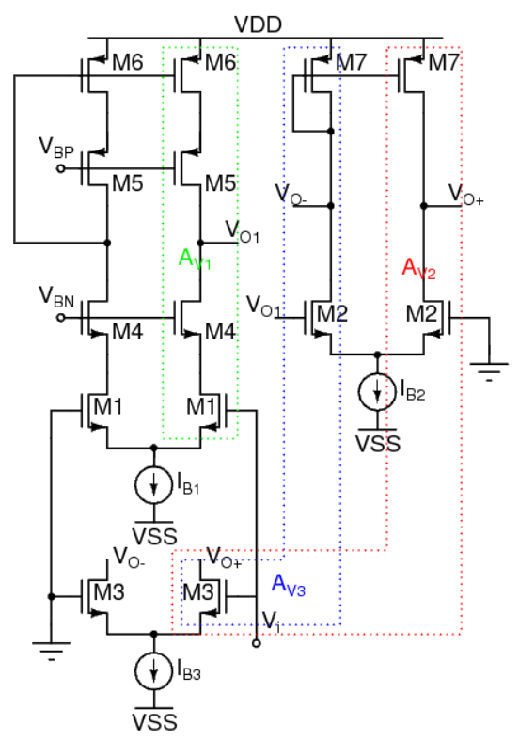
Pole Location [1]
Load capacitance (1st stage) and 1st pole:
C_{o1} ≈ C_{gs2} /2 + C_{gd4} + C_{gd5}
g_{o1} = (g_{m4} r_{ds4} r_{ds1} ) || (g_{m5} r_{ds5} r_{ds6} )
w_{p1} = g_{o1}/C_{o1}
Output conductance (2nd stage and FF path) and 2nd pole:
g_{o2} = g_{ds2} + g_{ds3} + g_{ds7}
C_{o2} ≈ C_{L}
w_{p2} = g_{o2}/C_{o2}
Fig. Single ended amplifier with NCFF compensation

Slide 13
Design Concern [1]
1st stage => Maximum gain
=> Low time constant (C_{o1} / g_{m1})
=> Small load capacitance for pole-zero cancellation at high frequency
=> Swing need not be high
2nd stage and FF path => High Bandwidth
=> High Transconductance (g_{m2} , g_{m3}) to push poles at high frequency
Fig. Single ended amplifier with NCFF compensation

Slide 14
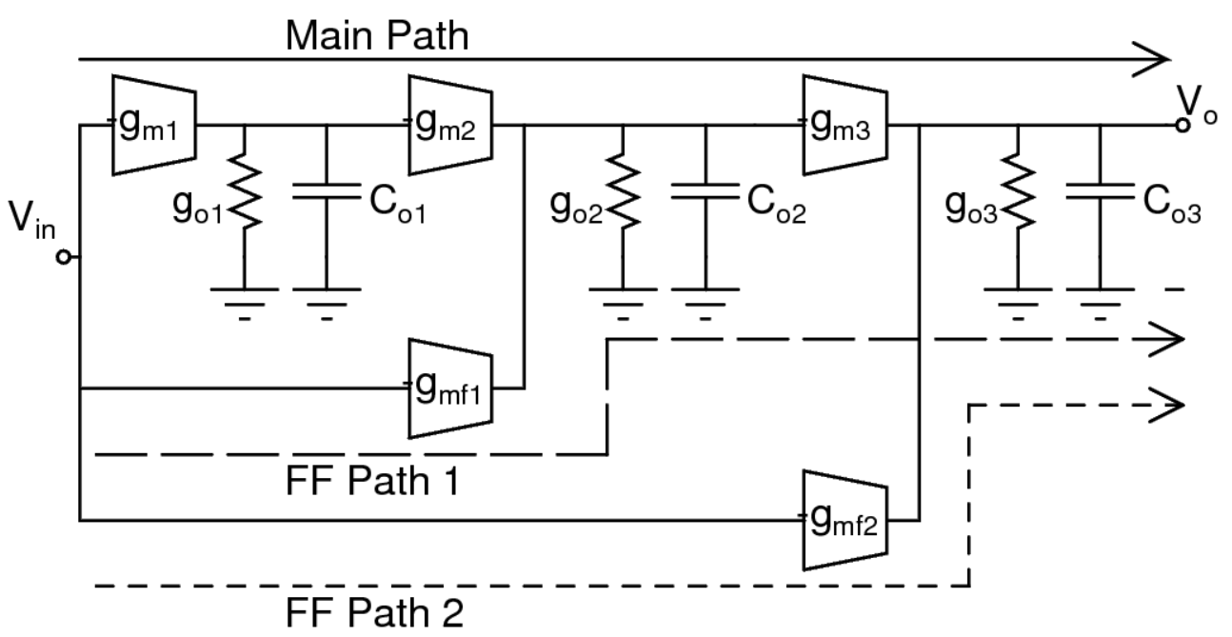
Three stage split-path Feedforward Compensation [2]
Main path has three stages
Gain of main path = Av₁ Av₂ Av₃ = - g_{m1}r_{o1}*g_{m2}r_{o2}*g_{m3}r_{o3}
1st stage has dominant pole: w_{p1} = 1/ r_{o1} C_{o1}
2nd stage and 1st FF path have common pole: w_{p2} = 1/ r_{o2} C_{o2}
3rd stage and 2nd FF path have common pole: w_{p3} = 1/ r_{o3} C_{o3}
Gain of 1st FF path = Av_{f1} Av₃ = - g_{mf1}r_{o2}*g_{m3}r_{o3}
Gain of 2nd FF path = Av_{f2} = - g_{mf2}r_{o3}
Overall DC gain = (( Av₁ * Av₂ + Av_{f1} ) * Av₃ + Av_{f2} ) > Gain of main path
Fig. Block diagram of three stage FFC opamp

Slide 15
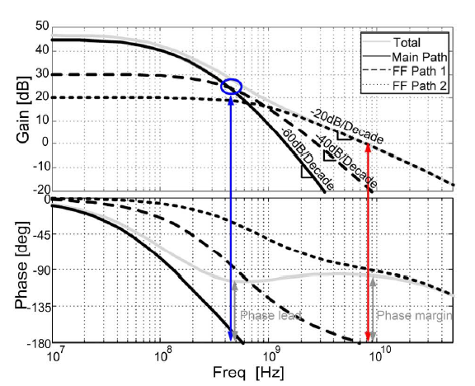
Features [2]
Features of Bode plot of three stage amplifier with NCFF compensation:
Stable due to its non-monotonic phase response
After compensation Phase Margin is stable
Phase Margin of 90° due to single pole
3 poles for main path => -60dB/Decade
2 poles for FF1 => -40dB/Decade
1 pole for FF2 => -20dB/Decade
After compensation => 1 pole left => -20dB/Decade
Fig.5 Bode Plot of multipath, multistage FFC opamp

Slide 16
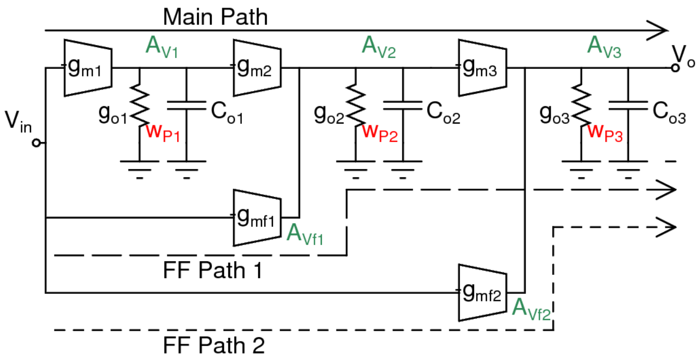


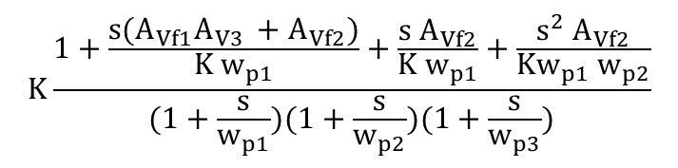

The overall Amplifier gain:
H(s) ≈
K = Overall dc gain =
Two LHP Zero and Three poles
Two LHP zeros:
w_{z1} w_{z2} =
Considering the similarities with two stage FF circuit:
w_{z1} ≈
Location of 1st LHP zero => 1st stage gain bandwidth product X K1
w_{z2} ≈
Location of 2nd LHP zero => Gain bandwidth product X K2
Where K1 and K2 are contant
$$K\frac{1+\frac{s{(A}_{Vf1}A_{V3 }+A_{Vf2})}{{K w}_{p1}}+\frac{{s A}_{Vf2}}{{K w}_{p1}}+\frac{s^{2} A_{Vf2}}{Kw_{p1} w_{p2}}}{(1+\frac{s}{w_{p1}})(1+\frac{s}{w_{p2}})(1+\frac{s}{w_{p3}})}$$
A_{V1} A_{V2} A_{V3} + A_{Vf1}A_{V3} + A_{Vf2}
$$A_{V1}w_{p1}\frac{A_{V2}}{A_{Vf1}}{{∗A}_{Vf1}w}_{p2}\frac{A_{V3}}{A_{Vf2}}$$
- $\frac{g_{m1}}{C_{o1}} \frac{g_{m2}}{g_{mf1}}$
Fig. Block diagram of three stage FFC opamp
- $\frac{g_{mf1}}{C_{o2}} \frac{g_{m3}}{g_{mf2}}$

Slide 17

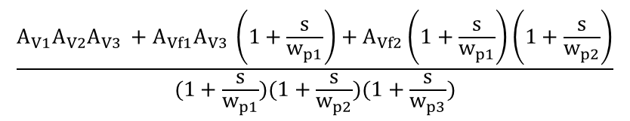



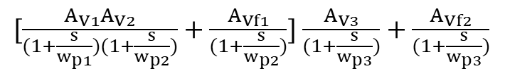

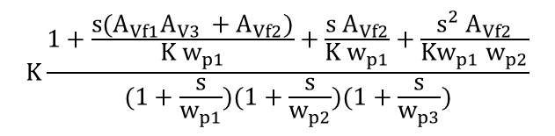

The overall Amplifier gain: [2]
H(s) ≈
=
=
Two LHP Zero and Three poles
Where K = dc gain = (A_{V1} A_{V2} A_{V3} + A_{Vf1}A_{V3} + A_{Vf2})
Two LHP zeros: [2]
w_{z1} w_{z2} =
=
=
Considering the similarities with two stage FF circuit:
w_{z1} ≈ -
= -
= Gain bandwidth product * K1
w_{z2} ≈ -
= Gain bandwidth product * K2
$[\frac{A_{V1}A_{V2}}{(1+\frac{s}{w_{p1}})(1+\frac{s}{w_{p2}})}+\frac{A_{Vf1}}{(1+\frac{s}{w_{p2}})}$] $\frac{A_{V3}}{(1+\frac{s}{w_{p3}})}+\frac{A_{Vf2}}{(1+\frac{s}{w_{p3}})}$
$$\frac{A_{V1}A_{V2}A_{V3 }+A_{Vf1}A_{V3 }+A_{Vf2}}{A_{Vf2}}w_{p1}w_{p2}$$
$$\frac{A_{V1}A_{V2}A_{V3 }}{A_{Vf2}}w_{p1}w_{p2}$$
$$\frac{A_{V1}A_{V2}A_{V3 }+A_{Vf1}A_{V3 }\left(1+\frac{s}{w_{p1}}\right)+A_{Vf2}\left(1+\frac{s}{w_{p1}}\right)\left(1+\frac{s}{w_{p2}}\right)}{(1+\frac{s}{w_{p1}})(1+\frac{s}{w_{p2}})(1+\frac{s}{w_{p3}})}$$
$$A_{V1}w_{p1}\frac{A_{V2}}{A_{Vf1}}{{∗A}_{Vf1}w}_{p2}\frac{A_{V3}}{A_{Vf2}}$$
$$K\frac{1+\frac{s{(A}_{Vf1}A_{V3 }+A_{Vf2})}{{K w}_{p1}}+\frac{{s A}_{Vf2}}{{K w}_{p1}}+\frac{s^{2} A_{Vf2}}{Kw_{p1} w_{p2}}}{(1+\frac{s}{w_{p1}})(1+\frac{s}{w_{p2}})(1+\frac{s}{w_{p3}})}$$
$$\frac{\frac{g_{m1}}{g_{o1}} \frac{g_{o1}}{C_{o1}} \frac{g_{m2}}{g_{o2}}}{\frac{g_{mf1}}{g_{o2}}}$$
$$\frac{g_{m1}}{C_{o1}} \frac{g_{m2}}{g_{mf1}}$$
$$\frac{g_{mf1}}{C_{o2}} \frac{g_{m3}}{g_{mf2}}$$

Slide 18
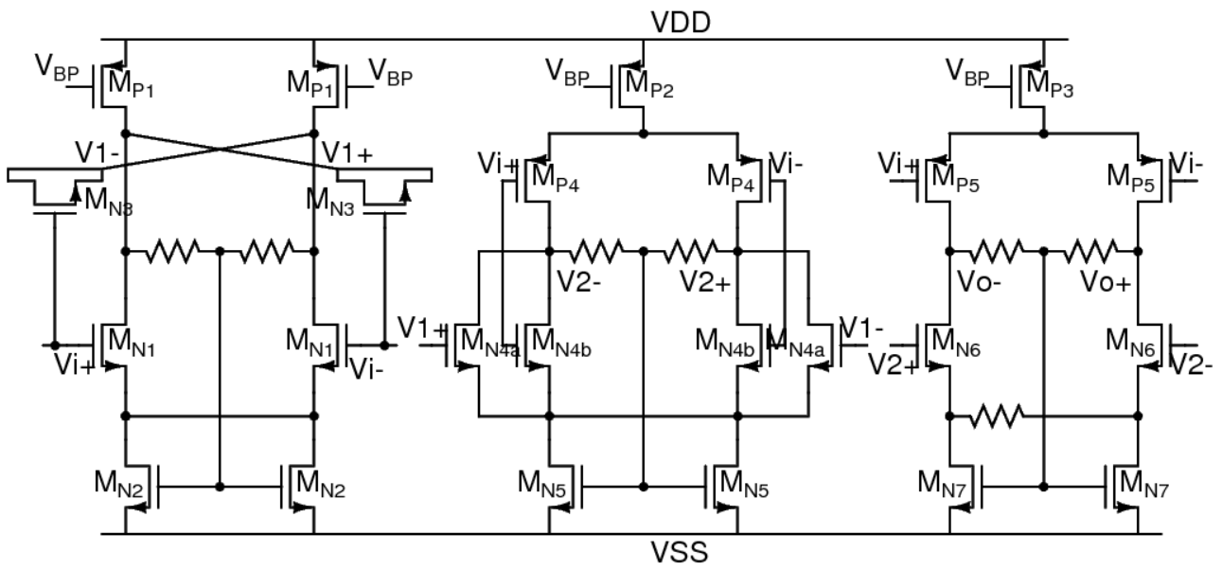
Implicit FFC scheme [2]
Explicit FF structures => introduces parasitic => degrade high-frequency characteristics and Stability
FF path is P-side of the CMOS-input structure of the 2nd
and 3rd stages
Main signal path is N-side
Tuning cannot be achieved by sizing of 2nd stage as both
g_{m2} and g_{mf1} have same bias current and r_{o2}
As it can change r_{o2} and hence the gain.
Fig. Three-stage op-amp with split-path implicit FFC

Slide 19
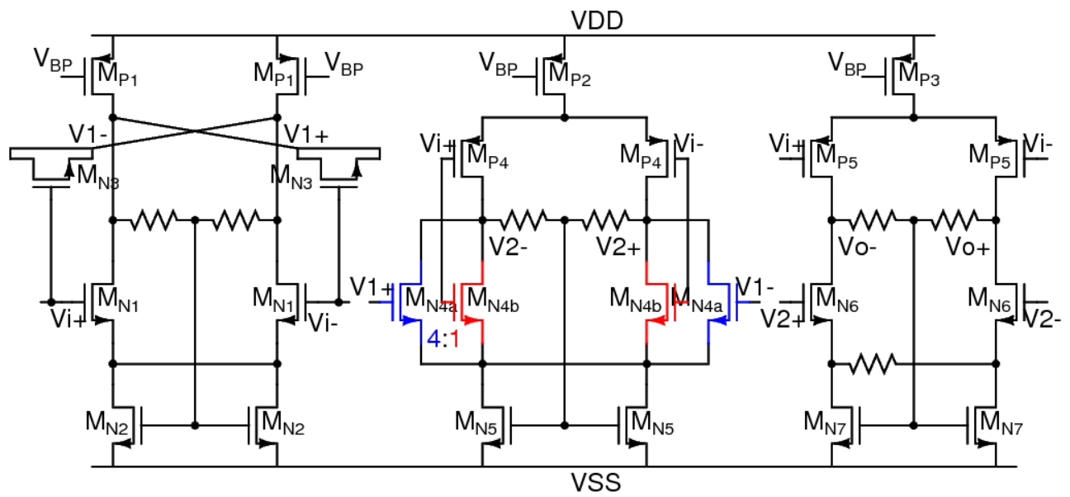
Design consideration [2]
1st stage gain should be high
Tuning the strength of main signal path and the FF path => 2nd stage NMOS input pair splits into two pairs => Transistor size ratio is 4:1
This technique is the split-path implicit FFC.
A local CMFB is used for CM gain stability.
Fig. Three-stage op-amp with split-path implicit FFC

Slide 20
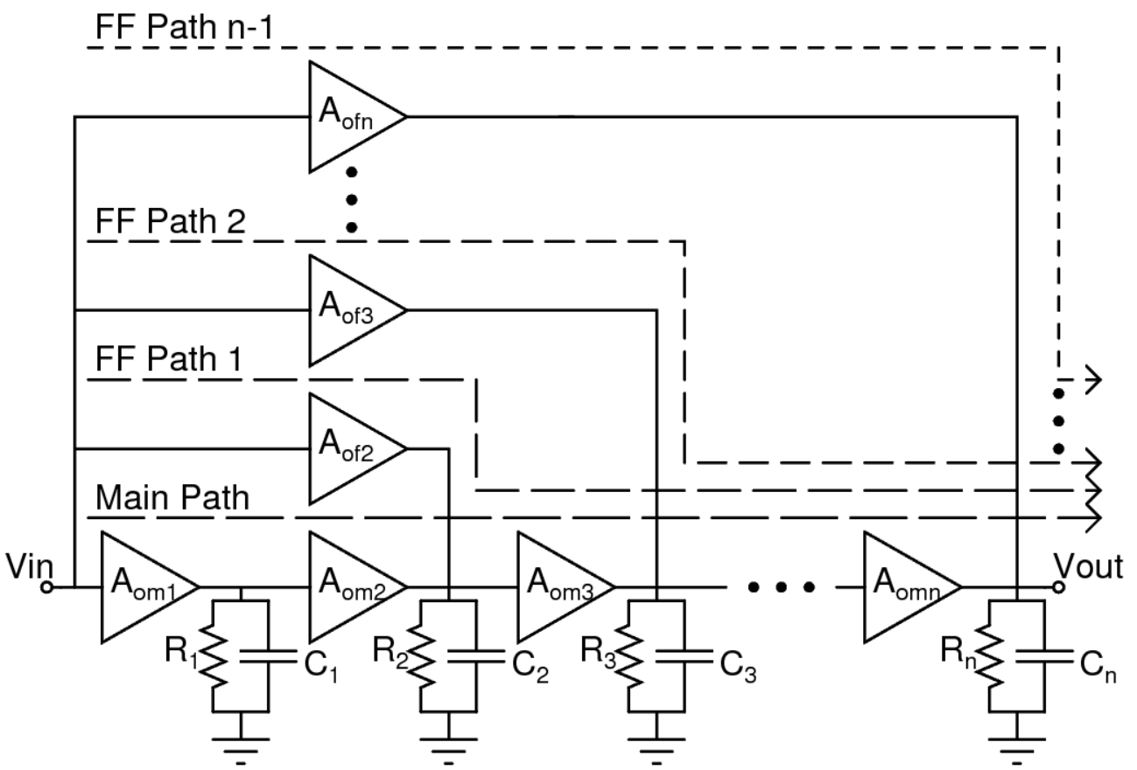
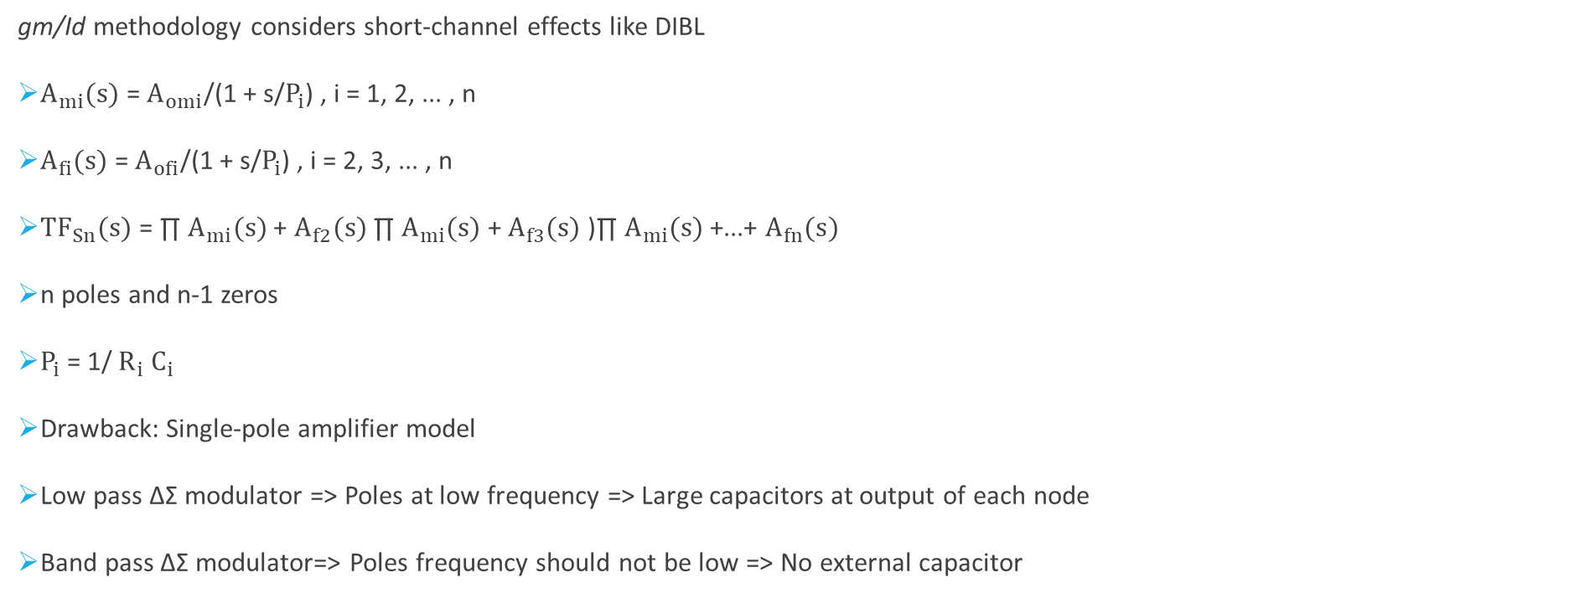
gm/ID methodology-based data-driven search algorithm [3]
gm/Id methodology considers short-channel effects like DIBL
$A_{mi}(s)$ = $A_{omi}$/(1 + s/$P_{i}$) , i = 1, 2, ... , n
$A_{fi}(s)$ = $A_{ofi}$/(1 + s/$P_{i}$) , i = 2, 3, ... , n
${TF}_{Sn}(s)$ = ∏ $A_{mi}(s)$ + $A_{f2}(s)$ ∏ $A_{mi}(s)$ + $A_{f3}(s)$ )∏ $A_{mi}(s)$ +...+ $A_{fn}(s)$
n poles and n-1 zeros
$P_{i}$ = 1/ $R_{i}$ $C_{i}$
Drawback: Single-pole amplifier model
Low pass ∆Σ modulator => Poles at low frequency => Large capacitors at output of each node
Band pass ∆Σ modulator=> Poles frequency should not be low => No external capacitor
Fig. System-level diagram of an nth-order FF-compensated op-amp

Slide 21
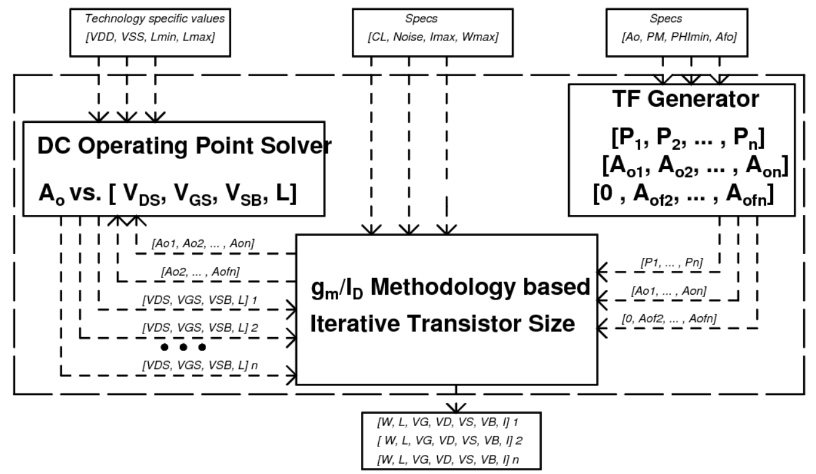
Components [3]
Each amplifier stage require:
Sizes of the transistors
The current consumption per stage
The body biasing voltages
TF generator: Four input parameters
Ao
PM
ϕmin for frequencies below fu
Afo central frequency gain
DC solver block gives dc operating point of the transistors
Main block is transistor size generator
Fig. Block diagram of the proposed sizing methodology

Slide 22
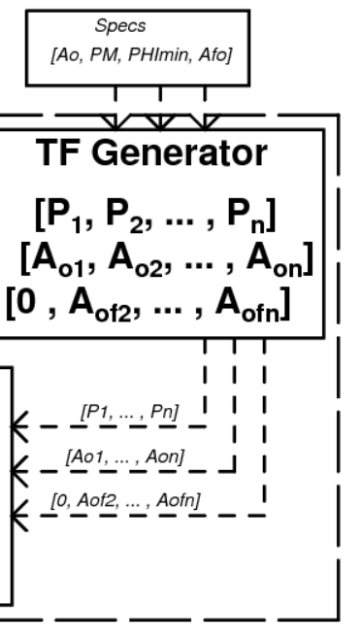
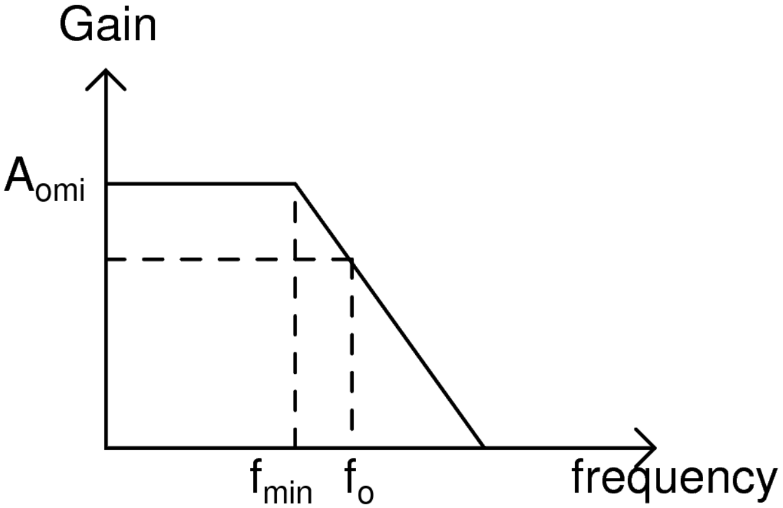
Algorithm 1: TF Generation for n-Stage Amplifier [3]
TF gives DC gain and pole location
Ami(s) = Aomi/(1 + s/Pi) , i = 1, 2, ... , n
Afi(s) = Aofi/(1 + s/Pi) , i = 2, 3, ... , n
Minimum pole => maximum frequency beyond which the gain of the multistage amplifier starts
to decrease
Initially, Minimum pole is set as ≤ fo/10, where fo is 3dB frequency => Iterate to give fmin ≈ fo
Fig. Gain vz. frequency
Fig. First Block

Slide 23
Flowchart for first algorithm [3]
Maximum current consumption per stage + Capacitive load driven by amplifier
Maximum current + Area
Maximum fu per stage
Required DC gain
Maximum pole
DC gain for each stage = the total desired dc gain / number of stage of the amplifier
Minimum pole = fu/max dc gain

Slide 24
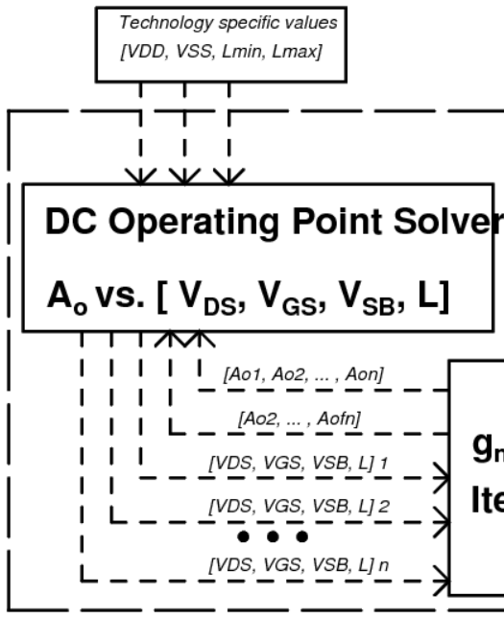
Algorithm 2: DC operating point solver [3]
Amplification stage is constrained using:
Technology-dependent values => VDD, VSS, Lmin, and Lmax, and values of
VGS/GD/GB/SD/SB/BD according to the safe operating area
System-level circuit constraints => input and output common-mode voltages
Constrained for each transistor within a narrow area of operating points:
Overdrive voltage (VOV) = VGS - VT
Saturation margin (VDSmarg) = VDS - VDSAT
These two are taken for region of operation
Input peak-to-peak voltage => SNR
Output voltage swing
Fig. Second Block

Slide 25

Flowchart for second algorithm [3]
DC gain from TF generator block
DC gain of a single amplification stage (either Ami or Afi)
= ((gm/Id)mi or fi)/((gds/Id)mi + (gds/Id)fi)
From lookup table, VGS, VDS, VSB and L is determined
$$\frac{g_{m}}{I_{d}}= \frac{2}{V_{GS} − V_{T}}$$

Slide 26
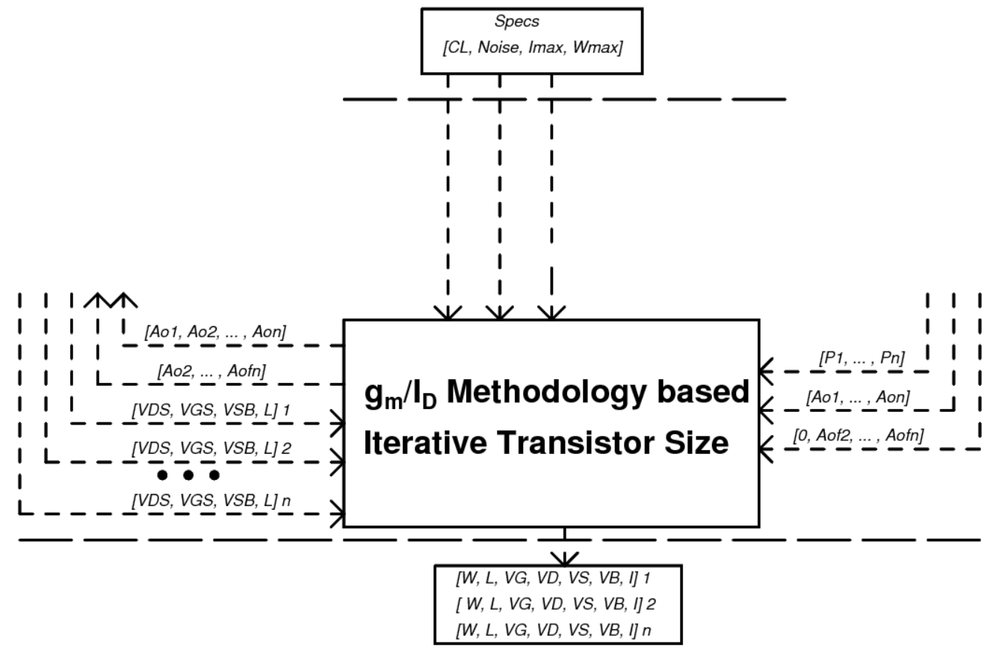
Algorithm 3: Transistor Size [3]
Main algorithm as it is for measuring size
Additional requirements for the final sizes =>
Cload
maximum width value
maximum current
noise
Fig. Third Block

Slide 27
Flowchart for third algorithm [3]
DC gain and pole from TF generator block gives Gain bandwidth product
Single pole amplifier => Gain bandwidth product = unity gain frequency (fu)
DC operating point will give gm/Id value
Using Cload and fu => calculate gm
Id is calculated using estimated gm and gm/Id
CLoad (Total) = Self-loading capacitors + the input load (Cgg)
The self-loading capacitors = zero (Initially)
Using dc operating point of each transistor and Id => Calculate width

Slide 28
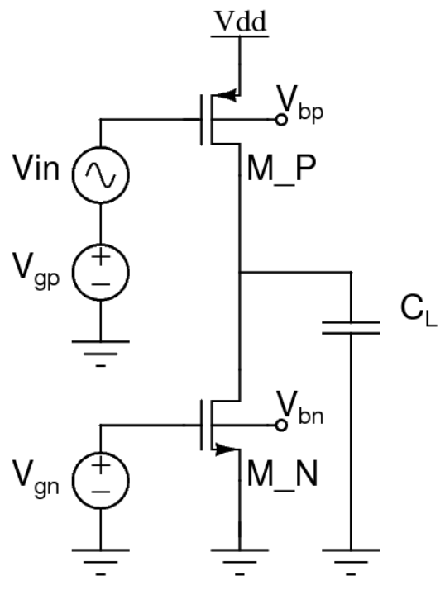
Validity of the Methodology [3]
Example to adjust limitation of single pole
pMOS => LVT => Input transistor
nMOS => RVT => active load transistor
2 poles and 1 RHP zero
gm/Id = 2/Vdsat
To increase fu => Current increases using Vov and not using width
Hence, Cgd remains same
Fig. Common source amplifier based on LVT pMOS and RVT nMOS

Slide 29
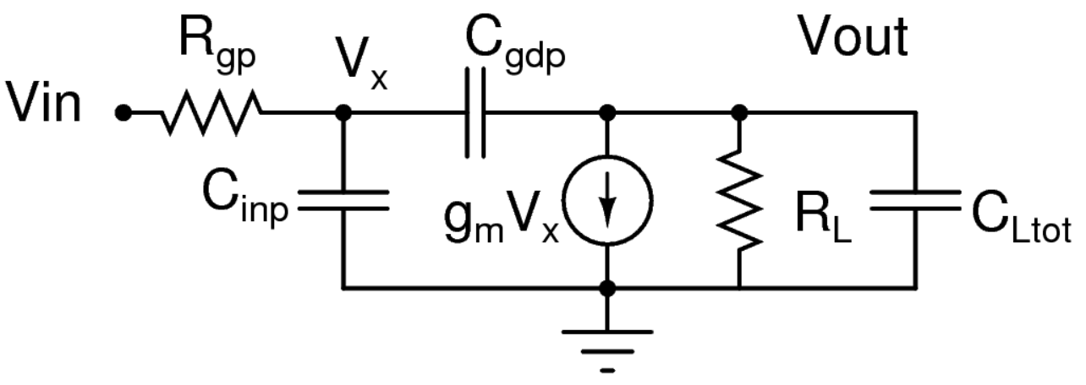
Small Signal Analysis of half circuit [3]
C_{Ltot} = C_{L} + C_{ddp} – C_{dgp} + C_{ddn} = C_{L}
C_{in} = C_{ggp} – C_{gdp =} C_{gsp} + C_{gbp}
1/R_{L} = g_{dsp} + g_{dsn}
Z_{tot} = R_{L} || 1/sC_{Ltot}
P1 = -1/ R_{L} (C_{Ltot} + C_{gdp} )
Non Dominant pole: Due to parasitic input resistance, Rgp
P2 = g_{mp} / 2π C_{ggp}
If fu < fT then its influence is minimum as this pole lies beyond fT
RHP Zero: Due to overlap capacitance, Cgd
Creates -90° phase shift and +20dB/Decade roll-off rate
Wz = g_{mp} / C_{gdp} = 10 * Wu then its effect is less on single pole model of amplifier
Fig. Small Signal Equivalent circuit

Slide 30
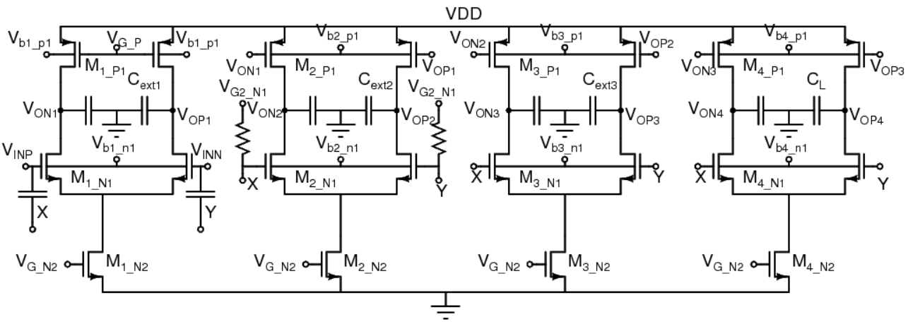
Fourth-Order Amplifier [3]
Fig. Fourth-order FF-compensated op-amp. External capacitors are added to account for interconnection parasitic capacitors.

Slide 31
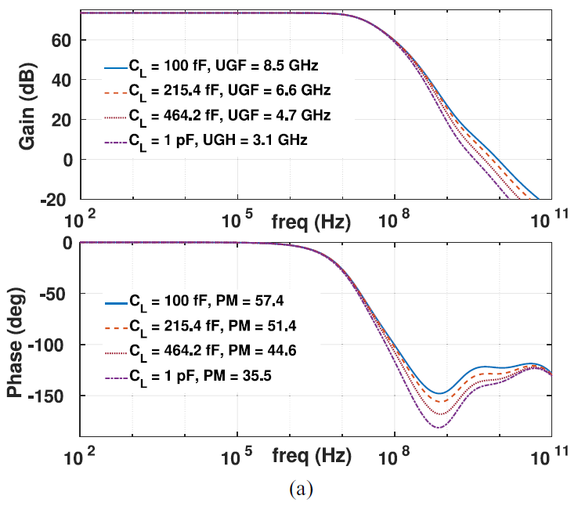
Frequency response [3]
Main path signals => LVT pMOS transistors
=> Gain
FF signals => RVT nMOS transistors
=> High Speed
No additional DC biasing
Same Body bias => zero
=> Same well
Fig. Effect of load variation on the frequency response of the fourth-order amplifier

Slide 32
Summary
Amplifier | 2 Stage FFC Paper 1 [1] | 3 stage FFC Paper 2 [2] | 4 Stage FFC Paper 3 [3]
Technology | AMI 0.5 um | 40 nm | 28 nm
Power Supply | ± 1.25 V | 1.5 V | 1 V
Gain | 94 dB | 50 dB | 73.5 dB
Bandwidth | 300 MHz | 16 GHz | > 1GHz
Phase Margin | 74 degree | > 42 degree | > 54.8 degree

Slide 33
Conclusion
Two stage amplifier with no miller capacitor feedforward compensation helps in achieving high gain of 94dB, high unity gain bandwidth of 300MHz and good phase margin of 74° [1].
Three stage amplifier with split path implicit FFC compensation adds little extra capacitance and the power overhead is almost zero due to the current reuse, hence it has good power efficiency. A local CMFB is also utilized to stabilize the CM gain. It has very high unity gain bandwidth of 16GHz and is unconditionally stable with phase margin greater then 42° [2].
Unlike conventional design methods, the fourth order amplifier is based on gm/Id methodology and helps in achieving the high unity-gain-frequency of greater than 1GHz and phase margin of greater than 54.8° [3].

Slide 34
References
B. K. Thandri and J. Silva-Martinez, "A robust feedforward compensation scheme for multistage operational transconductance amplifiers with no Miller capacitors," in IEEE Journal of Solid-State Circuits, vol. 38, no. 2, pp. 237-243, Feb. 2003, doi: 10.1109/JSSC.2002.807410.
B. Wu and Y. Chiu, "A 40 nm CMOS Derivative-Free IF Active-RC BPF With Programmable Bandwidth and Center Frequency Achieving Over 30 dBm IIP3," in IEEE Journal of Solid-State Circuits, vol. 50, no. 8, pp. 1772-1784, Aug. 2015, doi: 10.1109/JSSC.2015.2412953.
F. T. Gebreyohannes, J. Porte, M. -M. Louërat and H. Aboushady, "A gm/ID Methodology Based Data-Driven Search Algorithm for the Design of Multistage Multipath Feed-Forward-Compensated Amplifiers Targeting High Speed Continuous-Time ΣΔ-Modulators," in IEEE Transactions on Computer-Aided Design of Integrated Circuits and Systems, vol. 39, no. 12, pp. 4311-4324, Dec. 2020, doi: 10.1109/TCAD.2020.2966998.

Slide 35
Thank you!

